Slide 1
Automobile Insurance Complaints Rankings
Team ID: PTID-CDA-NOV-25-826
Project ID: cdacl-001
Presented By:
Kaneshk P M
Hari Prasanth S
Rihaaf Tawbeeqa
Gokul Krishnan B

Slide 2
Project Background
Automobile Insurance companies receive thousands of customer complaints annually.
Regulatory bodies track complaint outcomes such as:
  Upheld
  Question of Fact
  Not Upheld
Analyzing these companies helps assess company performance and compliance.

Slide 3
Project Objectives
Analyze complaint trends across filing years.
Compare insurance companies based on complaint volume and ratios.
Identify high-risk and low-performing companies.
Build interactive dashboards for business decision-making.

Slide 4
Dataset Overview
Source: Automobile insurance complaint dataset.
Key Columns:
  Company Name
  Filing Year
  Upheld / Not Upheld / Question of Fact Complaints
  Total Complaints
  Premiums written
  Complaint Ratio
Covers multiple companies across multiple years.

Slide 5
Tools & Technologies Used
SQL(MySQL):
  Performed data inspection, null validation, and record verification.
  Aggregated complaint data by company and filing year.
  Calculated complaint ratios, percentage distributions, and rankings.
  Identified top and worst-performing companies using ratio-based analysis.
Power BI:
  Built data model directly from SQL query outputs.
  Created interactive dashboards with slicers for company selection.
  Visualized complaint distribution, trends, and rankings.
  Designed diagnostic summaries to highlight key compliance insights.

Slide 6
SQL Data Inspection & Validation
Verified table availability and sample records.
Checked total number of records and distinct companies.
Identified filing year coverage.
Performed null value validation on critical columns.
Ensured data readiness for analytical queries.

Slide 7
SQL Complaint Analysis
Calculated year-wise total complaints.
Analyzed complaint type distribution:
  Upheld
  Question of Fact
  Not Upheld
Computed percentage contribution of each complaint type.
Identified complaint trends over time.

Slide 8
SQL Company-Level Analysis
Total Complaints by company.
Upheld Complaints by company.
Premium contribution by company.
Complaints vs Premiums comparison.
Complaints per million dollars of premium.

Slide 9
SQL Ratio & Ranking Analysis
Validated complaint ratios by company and year.
Generated year-wise company rankings based on complaint ratio.
Identified worst-performing companies by average complaint ratio.
Extracted top and bottom performers for dashboard comparison.

Slide 10
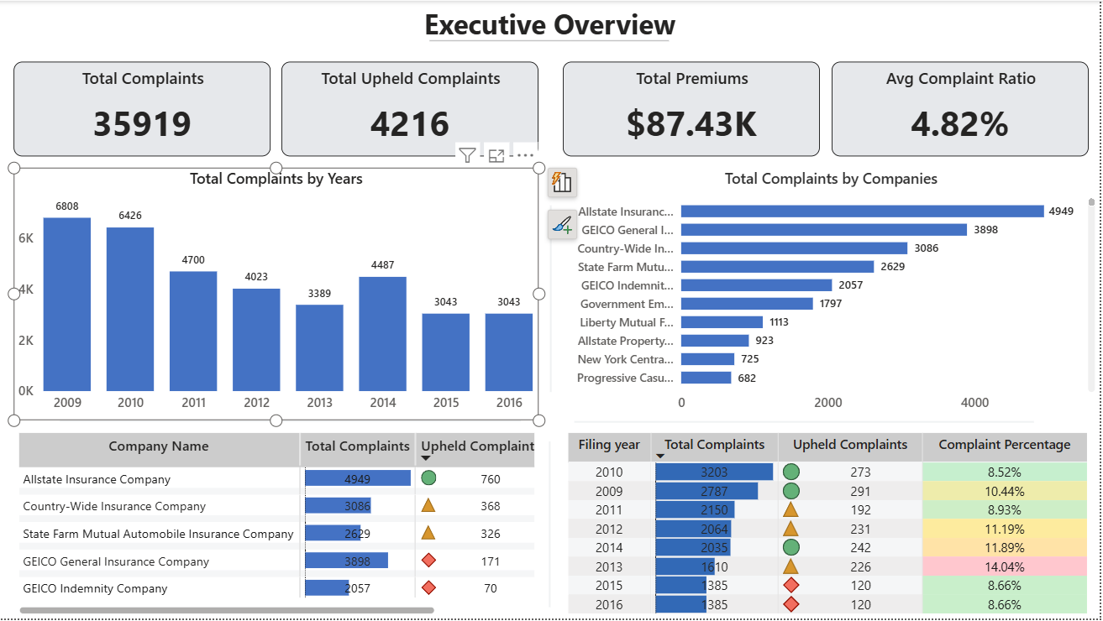
Power BI Dashboard Overview
High-level KPIs on complaints and premiums.
Year-wise complaint trends.
Overall distribution of complaint outcomes.
Interactive slicers for company selection.

Slide 11
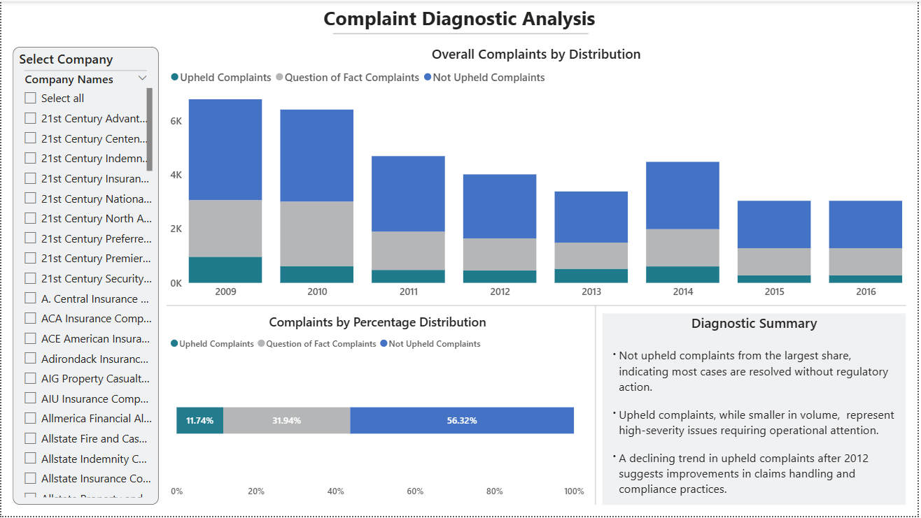
Power BI Diagnostic Analysis
Breakdown of complaint outcomes over time.
Percentage distribution of Upheld vs Not Upheld complaints.
Diagnostic summary highlighting key observations.
Helps identify compliance and operational issues.

Slide 12
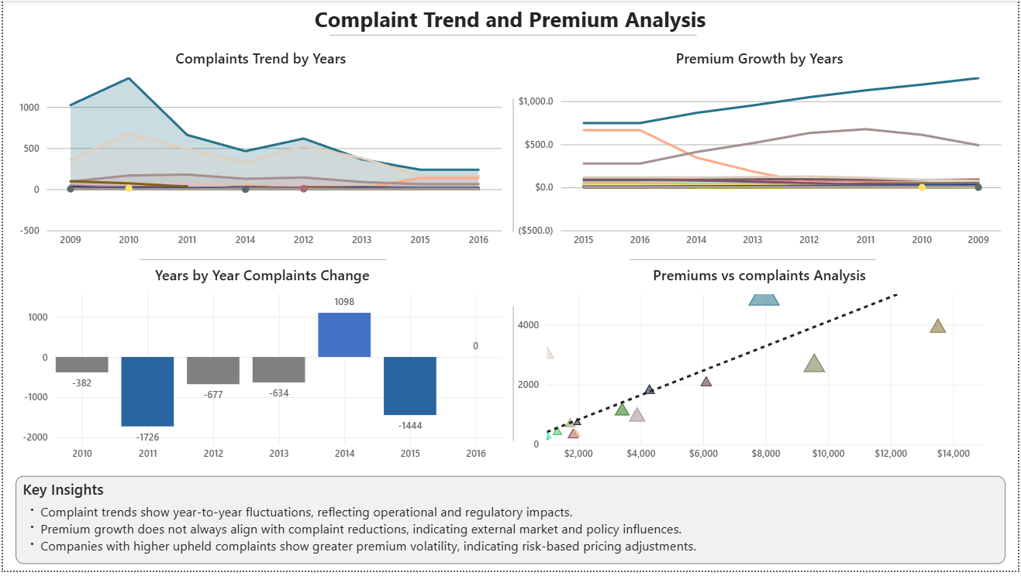
Power BI Trend & Premium Analysis
Complaint trends compared with premium growth.
Year-wise premium analysis.
Relationship between business size and complaint volume.
Identification of abnormal spikes and drops.

Slide 13
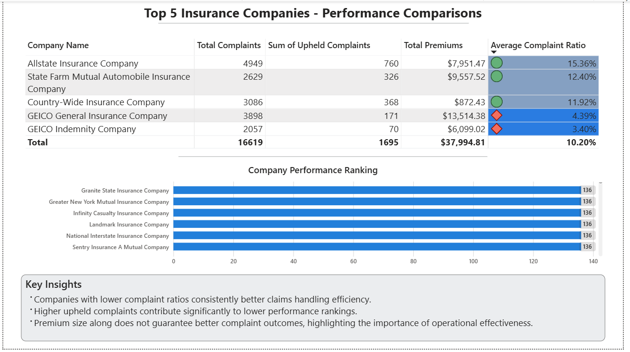
Power BI Company Comparison
Side-by-side comparison of top companies.
Metrics included:
  Total Complaints.
  Upheld complaints.
  Premiums.
  Average complaint ratio.
Ranking visualization from best to worst performers.

Slide 14
Key Insights & Findings
Not Upheld Complaints form the majority, indicating resolution without regulatory action.
Upheld complaints, though fewer, highlight serious operational gaps.
Some companies show high complaint ratios despite lower premiums.
Overall improvement observed in complaint handling after certain years.

Slide 15
Conclusion & Business Impact
The project delivers a data-driven evaluation of insurance companies.
Helps regulators and management identify risk-prone companies.
Enables better compliance monitoring and decision-making.
Demonstrates strong integration of SQL analytics with Power BI reporting.

Slide 16
Thank You

